Slide 1

Intro to NServiceBus
1 – Introduction

Slide 2
What is NServiceBus?
a powerful, extensible framework that will help you to leverage the principles of Service-oriented architecture (SOA)
that will help you to leverage the principles of Service-oriented architecture (SOA) to create distributed systems that are more reliable, more extensible, more scalable, and easier to update.

Slide 3
Goals of SOA and NServiceBus
Be able to build systems that can easily scale out
Reliably perform non-transactional tasks
Easily start up long-running processes in an application server layer
Unravel your spaghetti codebases into a logical system of commands, events, and handlers

Slide 4
Why NServiceBus
It’s a distributed bus and not a broker
Messaging pub/sub async processing
Durable and transactional
Has support for long running transactional flows of messages (sagas)
And it’s fundamentally really simple to use

Slide 5
And Honestly…
If you learn something from all these courses…
It’s about:
Decoupling
Asynchrony
Injection of services
A bus lets you inject services into your applications

Slide 6
Scalable Systems are Distributed
Different locations
Clustered for availability
Horizontally scaled out
Standard RPC models don’t work with this, because…

Slide 7
Fallacies of Distributed Computing
The network is reliable
Latency isn’t a problem
Bandwidth isn’t a problem
The network is secure
The topology won’t change
The administrator will know what to do
Transport cost isn’t a problem
The network is homogeneous

Slide 8

Coupling
Platform
Interoperability matters( Fallacy #8 )
Proprietary vs. Standard protocols
Schema & Contract – XML
Spatial
Server A relies on Server B
Can communication continue?
Store & Forward
Temporal
The processing of B affects that of A
Request/Response
Asynchronous Messaging
Windows
Linux
RPC

Slide 9
CAP Theorem
any distributed system you can only have any two of the following:
Consistency,
Availability, and
Partition tolerance

Slide 10
Messages to the Rescue
Communication between services and Endpoints is described by message patterns
Durable
Flexible
Unidirectional – non-blocking
Less coupling
NServiceBus provides several messaging patterns out of the box, but allows for the composition and/or creation of new patterns

Slide 11
Now, I can’t believe…
It took me this long to mention…
Command Query Separation
Single Responsibility

Slide 12
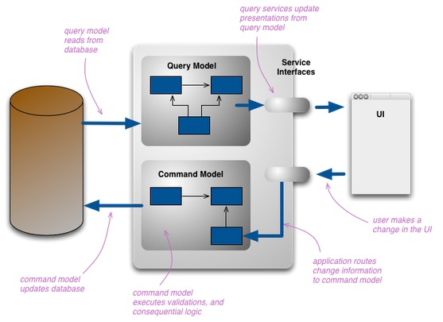
Command Query Responsibility Segregation
Commands should be sent separately than requests for data
Each can be on its own channel and routed to different places
Commands can scaleout with CPUs
Data requests route to caching servers
http://martinfowler.com/bliki/CQRS.html

Slide 13
With CQRS
Your app behaves asynchronously
Commands are issued to backend services and simply acknowledged.
Requests for data also
Replies come back in later and are correlated with requests

Slide 14
CQRS: Command Query Separation
If you adopt one pattern….
This is one I recommend to be that one
Nothing will help you more with scalability
It is an asynchronous messaging state of mind

Slide 15
The Crux of the Point
By using asynchronous commands, the focus shifts from trying to guarantee consistency that was impossible in the first place to ensuring that the commands do eventually succeed through automatic retries.

Slide 16
Single Responsibility
In object-oriented programming, the single responsibility principle states that every class should have a single responsibility, and that responsibility should be entirely encapsulated by the class. All its services should be narrowly aligned with that responsibility.
In SOA, this means each service does this.

Slide 17
With Single Responsibility Services
You can attach services to a bus
Scale them out
Replace them with other implementations as needed
If your apps adopt this, then you can massively scale out

Slide 18
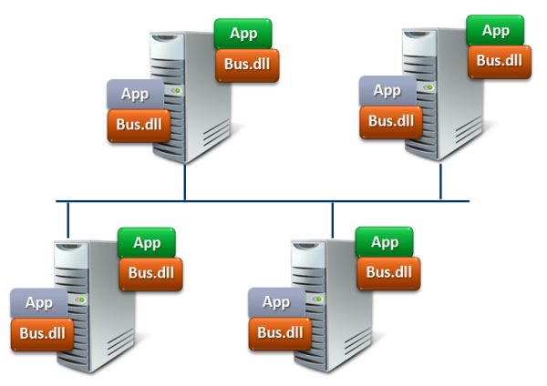
Nservice Bus is Not a Broker
It is a bus
All it does is:
Receive messages
Reliable store them
Ensure delivery to an endpoint, or graceful fail-over
Manage transactions across messages
All actions are non-blocking / Async
Does not make decisions on routing

Slide 19

A Broker
Makes decisions on routing
Often is a central service
IE: BizTalk

Slide 20
How is NSB different form WCF?
Fault tolerance
Enforced resiliency
Transactional
Long-running processes
WCF integrates with WF but transaction and exception boundaries are not specified
NServiceBus ensures this

Slide 21
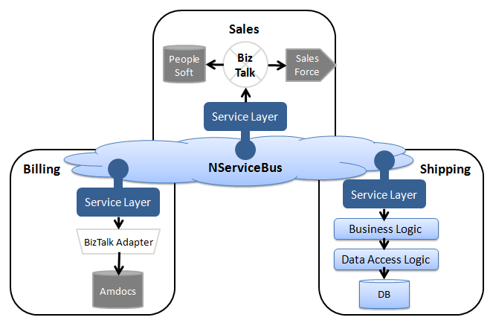
How is it different from BizTalk
Decentralized vs Centralized
BizTalk pushes you to centralized logic and spaghetti code
http://download.microsoft.com/download/B/0/6/B0678433-88EA-44D4-8C4C-F4AA5DFC4C58/nServiceBus%20and%20BizTalk%20Server.docx

Slide 22
NServiceBus is Deceptively Simple
Senders and Receivers
Each has a one or more message queue addresses
Send messages to the “Bus”
The Bus gets it there or gracefully lets you know it didn’t arrive

Slide 23
Architectural principles in NSB
Messaging:
Store and forward
Request / response
Publish and subscribe
CQRS (there’s that term again)
Services listen on endpoints
Messages are sent to endpoints asynchronously

Slide 24
Messaging patterns supported
Store and forward
Request / reply
Pub / sub

Slide 25
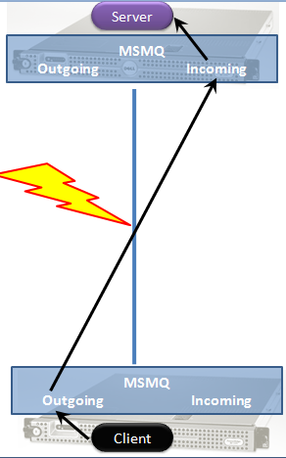
Store and Forward
Client gives message to endpoint
If the endpoint does not receive, client gets error
From then on, the bus forwards it to the actual destination

Slide 26
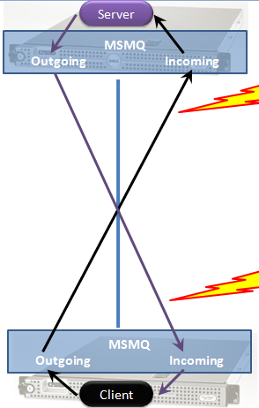
Request / response
Two one-way async messages
Client continues on and receives response later
This is usually correlated

Slide 27
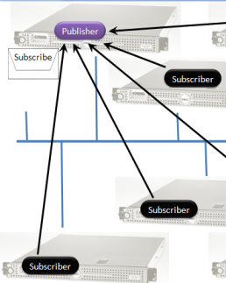
Pub / Sub
Clients subscribe to an endpoint
A server sends a message to that endpoint
All subscribed clients receive a copy of the message
The message is then removed
If no clients attached, the message goes away

Slide 28
Three primary types of messages
IMessage | Base type for messages
ICommand | One logical owner Can not be published Cannot be subscribed and unsubscribed Cannot implement IEvent
IEvent | Can be published Can be subscribed and unsubscribed to Cannot be send using Bus.Send() Cannot implement Icommand Cannot be send using the Gateway
All are empty interface and only used for convention based rule enforcement

Slide 29
Addressing
Messages are sent and received from endpoints
Endpoints to an app are names
Under the covers, NServiceBus maps endpoints to queues in MSMQ
Messages are durable via MSMQ

Slide 30
Transports
The default transport is MSMQ
Others can be swapped in:
Raven
SQL Server
Nhibernate
Raven currently is used only for state data in the server, not messages
And this can be swapped out too

Slide 31
Persistence
Two types of persistence: state and messaging
Messaging persistence is handled by the message transport
State within a node is handled by configuration using any of the following:
RavenDB
SQL Server
MSMQ

Slide 32
Summary
We went over a number of topics around patterns of SOA
Loosely coupled
CQRS
Store/Forward, Request/Reply, Pub/Sub
Introduced the problems of distributed software and how NServiceBus addresses those issues

